Slide 1
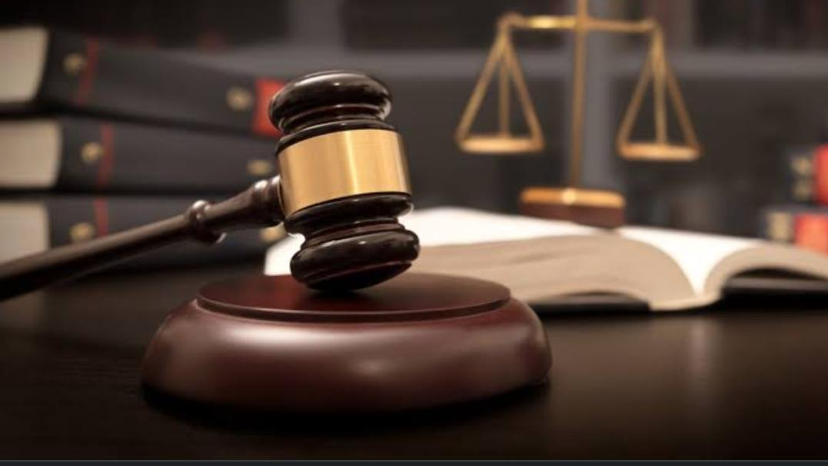

Slide 2

WELCOME TO :
LAW CHAMBER OF RAJEY JAIN
More than 9 years of experience
3rd generation lawyer

Slide 3
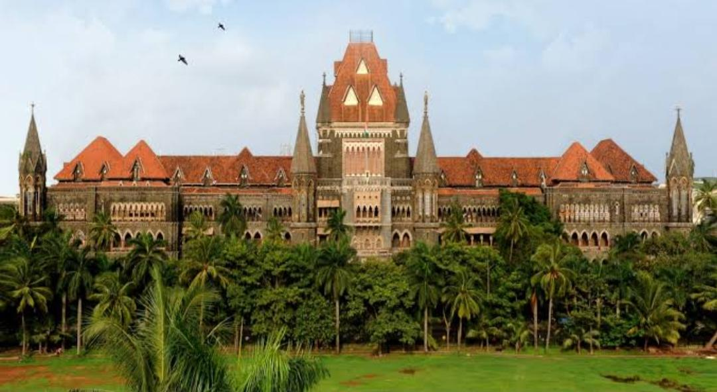
ABOUT US :
ADV. RAJEY NARESH JAIN
ADVOCATE OF ALL HIGH COURT IN INDIA
Qualifications:-
B.Com,M.Com,L.L.B.,L.L.M.
Specialised in:-
Corporate laws and Criminal laws
MEMBER OF PANVEL DISTRICT COURTS BAR ASSOCIATION
MEMBER OF THANE DISTRICT COURTS BAR ASSOCIATION

Slide 4

AIM:
TO PROVIDE BEST SERVICE TO THE CLIENT

Slide 5

ACHIEVEMENT:
WE HAVE WON ALL THE CASES FOR OUR CLIENT’S WHO REACHED OUR CHAMBER.

Slide 6
List of cases that we have won:
Shila Art Packaging vs Celogen Pharma Pvt Ltd
Aqsa Polypack vs Celogen Pharma Pvt Ltd
Aqsa Polypack vs Celogen Generics Pvt Ltd
Emkay Pharma vs Celogen Generics Pvt Ltd
Shree Arun Packaging vs Celogen Pharma Pvt Ltd

Slide 7
Ok Print and packs vr Celogen Generics pvt Ltd
Times Press people vs Celogen Generics Pvt Ltd
Sankalp Health care and Allied Products vs Par Laboratories
Shree Chemicals vs Celogen Pharma
Shree Chemicals vs Celogen Generics
LANDMARK JUDGEMENT:
Simson pharma Ltd vs Celogen Generics Pvt Ltd

Slide 8
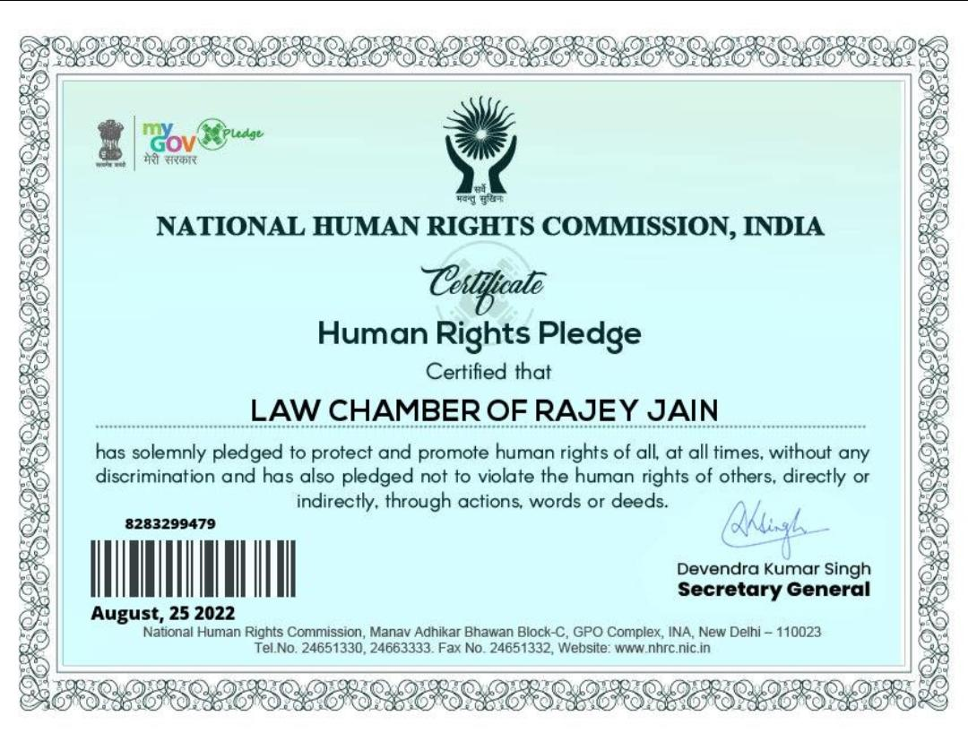

Slide 9

CASES:
ALL TYPES OF LITIGATION:
CORPORATE , CRIMINAL , CIVIL, REVENUE, LABOUR , ARBITRATION, MEDIATION , NCLT, NCLAT , ETC

Slide 10

Contact Us:-
+91 9773573126
+91 9833863063
lawchamberofrajeyjain@gmail.com
ADDRESS:
PARAKH NIWAS ,D-12, SEC-12 , KHARGHAR, NAVI MUMBAI, 410210

Slide 11


